Slide 1
Assignment 3
Completed the assignment on synchronizing an asynchronous input with internal clock and counting

Slide 2
We were given the following targets-
Consider a situation where you have a asynchronous signal such as long pulse width (say 500 us, randomly occurring) aperiodic signal coming from outside to your FPGA. Now this is has to be synchronised to your internal clock of the FPGA. How would you do it ?
Now that you have synchronised the signal, can we detect only edge of the signal in a always block running on internal clock of the FPGA ?
Once first two assignments are done, now can you write a counter to count these ‘edges’ ?
Add a ‘Gating’ to the counter. I.e one more external signal ‘gate’ is added such that counter only counts when gate is present and on the falling edge of the gate, stores the current value of count to a local register and resets itself on falling edge of the gate.
Create a detailed presentation of this project including resource use summary, RTL schematics and post implementation FPGA layout. Try to explain what you see.

Slide 3
Our solution-
Our solution consists of three modules apart from the simulation module-
sync- This module is used to synchronize the asynchronous input with the internal clock.
compare- This module is used to detect the edges of the input signal in an always block while running on the internal system clock.
counter- This module consists of a counter that counts the edges and also a gating such that the counter counts only when a gate signal is present.

Slide 4
1.Synchronizing asynchronous input with system clock
A few basic terms related to sequential logic:
Setup Time:Setup time is defined as the minimum amount of time before the clock's active edge that the data must be stable for it to be latched correctly. In essence, any sequential element needs some time for the data to remain stable before the clock edge arrives in order to capture the data reliably. Hence, the data that was transmitted at the rise of the previous clock edge must remain stable for at least the setup time of before the next clock edge.
Hold Time:Hold time is defined as the minimum amount of time after the clock's active edge during which data must be stable. Similar to setup time, any sequential element requires the data to remain stable for an interval of time in order to be captured reliably. In essence, the data transmitted at the current edge of the clock cycle must not travel to a capturing flip-flop before the hold time has passed.It ensures that the data transmitted at the current edge does not end up being captured at the same edge.

Slide 5
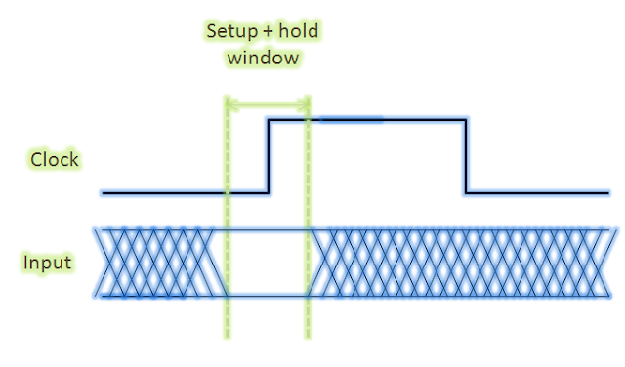
Setup and Hold Window
Thus, the input is allowed to change at any point except for the setup and hold window.

Slide 6
Problems
If the input changes within the setup and hold window, the following may occur::
Non-propagation of the new value.
Occurrence of metastability.
Metastability: Metastability is a phenomenon of unstable equilibrium in digital electronics in which the sequential element is not able to resolve the state of the input signal; hence, the output goes into unresolved state for an unbounded interval of time.When a flip-flop enters metastable state, one cannot predict its output voltage level after it exits the metastability state nor when the output will settle to some stable voltage level.
Example: If R=0 and S=0 for an SR flip-flop due to a change in the inputs within the setup and hold window, it enters an undefined state where the output does not have a stable value.

Slide 7
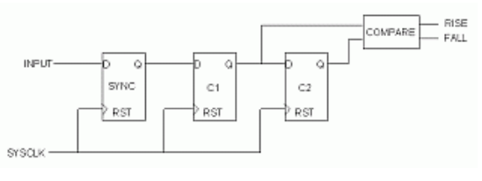
Solution
Thus, due to the various reasons stated in the previous slides, our first task is to obtain a synchronous version of the asynchronous input signal.
This synchronization is achieved by using a two-stage shift-register.
The sync.v takes the asynchronous (async_ip) signal and clock (clk) as input and outputs a signal signal (sync_op) that is synchronized with the clock.
To accomplish this task we referred the following link- https://www.doulos.com/knowhow/fpga/synchronisation/

Slide 8
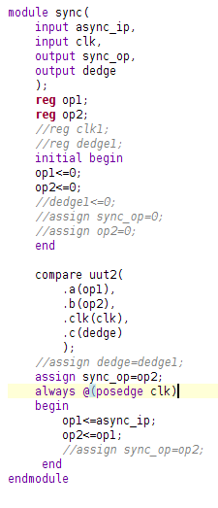
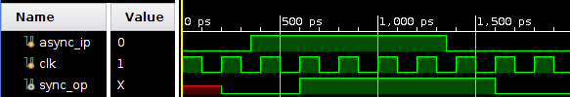
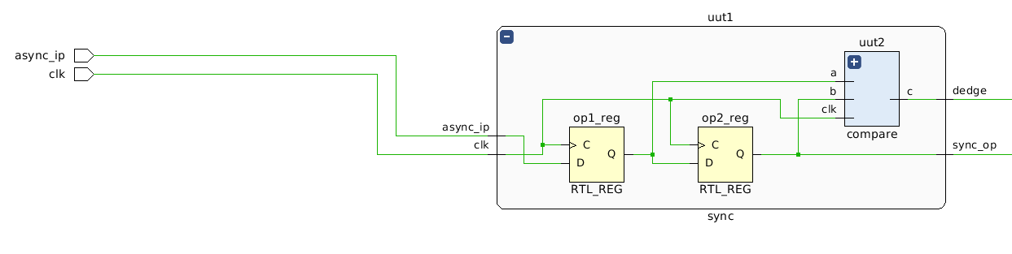
sync.v

Slide 9
2. Detecting only the edges of the asynchronous input signal
This is done using the compare.v module. This module takes the synchronized signal (sync_op), an intermediate signal (op2) and the system clock (clk) as inputs and returns a signal dedge which has value logic one whenever the input signal changes. Thus for a single asynchronous input signal the signal dedge becomes high twice. First for the positive edge and then for the negative edge of the input signal.

Slide 10
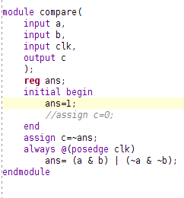
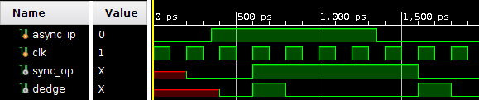
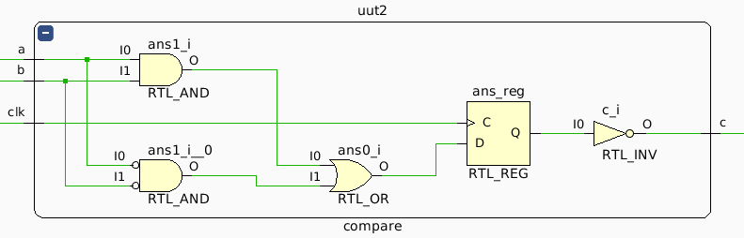
compare.v

Slide 11
3. Counting the number of edges-
Here we made a counter module which gives a vector count (16 bit) as output. Initially the value of count is set to 0. The value of count is increased by 1 alternatingly whenever the counter module receives a positive edge on input signal dedge. This is done alternatingly as the module compare recognizes both the positive as well as negative edge of the asynchronous input signal.

Slide 12
4. Adding a gating to the counter
We added a “Gating” mechanism to the counter such that the counter only counts when an input signal gate is high. Falling edge of the gate signal stores the value of the counter to the vector count (16 bits).

Slide 13
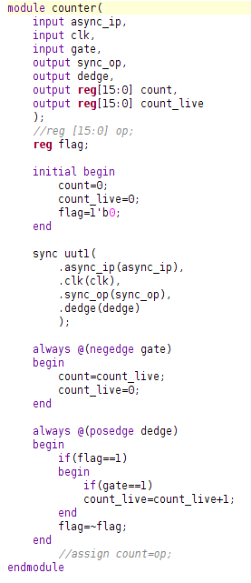
counter.v

Slide 14
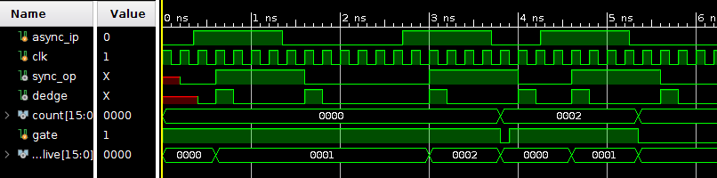
When gate is high-

Slide 15
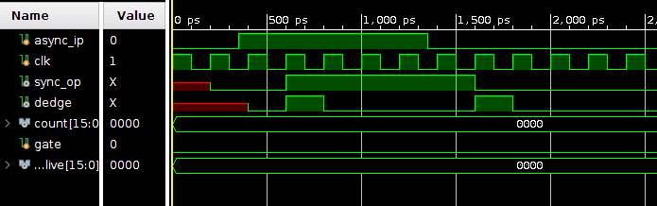
When gate is low-

Slide 16
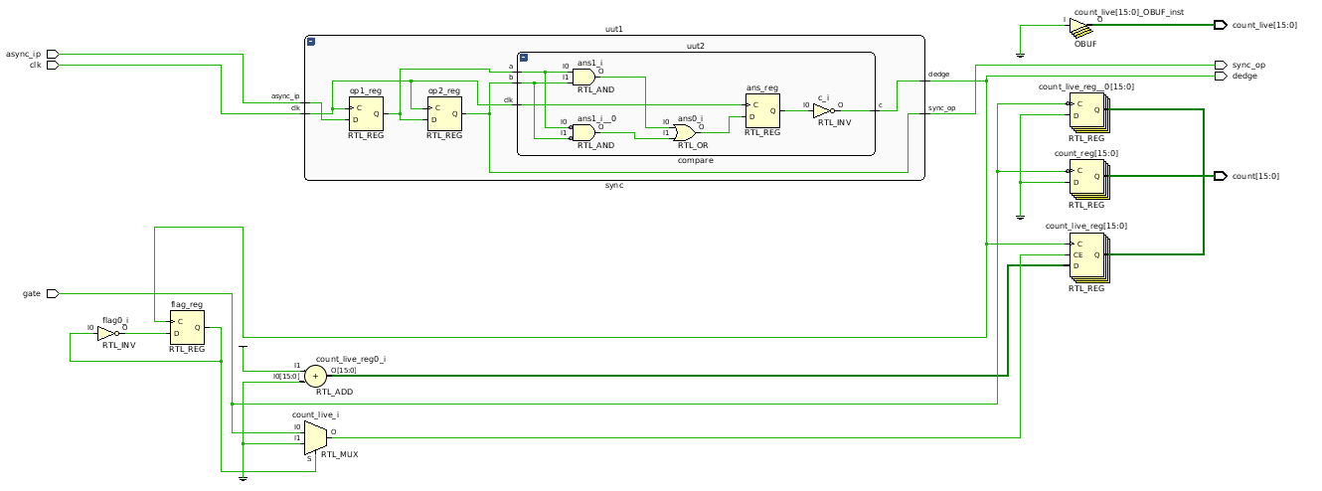
5. RTL Schematic-

